Slide 1
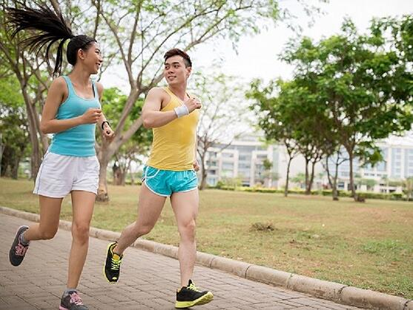
WELLNESS CLUB
ADVISOR SEAN GIBLIN
PRESIDENT MADISON FEDUN

Slide 2
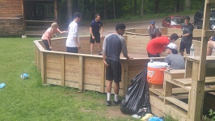
WHAT WE DO
We are a student-centered club that raises awareness on various aspects of the wellness culture of Delaware Valley. Our goal is to promote, expand, and create more opportunities to be active outside of the traditional physical and educational classes and interscholastic sports already provided.

Slide 3
